Slide 1

SQL Training
Phillip Willsey / Blake Northam
Eric Smith / Madelyne Weber

Slide 2

Agenda
SQL Training
How we got here
Why use a database
Anatomy of a SQL statement
Creative anatomy
Making your mark on the world
Shooting yourself in the foot
Getting data in and out of the database

Slide 3
A Brief History of Database Models
SQL Training
How we got here
In the 1960s, two database structures emerged: hierarchical and network models.
In 1970, Edgar Codd introduced a database model grounded in mathematical theory: the relational database model.
In the 1980s, relational database management systems (RDBMS) became widely used.
Trends since then have included XML, object stores, and schema-less “NOSQL” databases, but RDBMS continue to be the best choice for most applications.
In this presentation, the term ‘database’ will refer to RDBMS.

Slide 4
Agenda
SQL Training
How we got here
Why use a database
Anatomy of a SQL statement
Creative anatomy
Making your mark on the world
Shooting yourself in the foot
Getting data in and out of the database

Slide 5
SQL Training
Why use a database
Databases are very popular – for a good reason!
Relational databases are used by most major companies – because they are a great way of representing and storing data.
A relational database is a shared collection of logically related data, and a description of this data, designed to meet the information needs of an organization
Users can control data redundancy, share data, and improve integrity without sacrificing performance or security

Slide 6
SQL Training
Why use a database
Some advantages of the Relational Database Model are…
Control of data redundancy
Data consistency
Sharing of data
Improved data integrity
Improved security
Economy of scale
Improved data accessibility and responsiveness
Improved maintenance through data independence
Increased concurrency
Improved backup and recovery

Slide 7
SQL Training
Why use a database
Let’s look at an example:
We are tracking scores for M’s golf club. The previous scorekeeper retired to the Caribbean, leaving us a spreadsheet with scores for the last twenty years. Here’s a sample:
This spreadsheet has a few errors… How many can you spot? (ASOP 23)
1st normal form

Slide 8
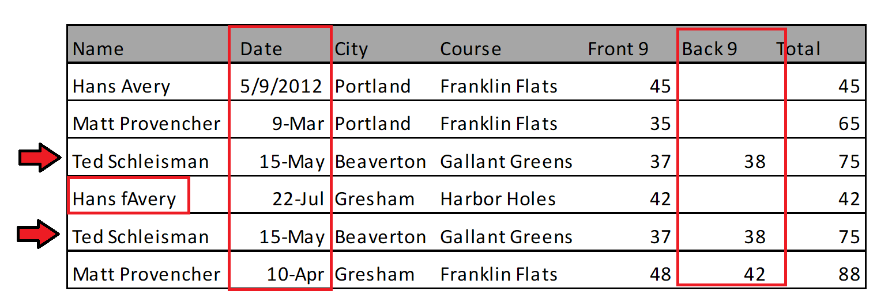
SQL Training
Why use a database
Errors:
Name misspelling
Inconsistent course location
Inconsistent data formats
Empty fields
Incorrect totals
Duplicate entry
Potential Difficulties:
Redundant data tools
Horizontal data elements
Multiple entries of identical data

Slide 9
SQL Training
Why use a database
How do I design a database?
A relation is a table with columns and rows.
A relational database is a collection of normalized relations with distinct relation names.
A relational key (or superkey) is an attribute of set of attributes that uniquely identifies a tuple within a relation.
Primary keys, foreign keys, candidate keys
How can we normalize our golf course scores? What unique attributes can we define?

Slide 10
SQL Training
Why use a database
Reorganize the data
We can separate out the players, courses, and scores into their own relations.
We can define each unique player and course – and associate scores to a unique combination of player + course + date.
We can track the score for each hole a player plays – and sum all holes for a total score!

Slide 11
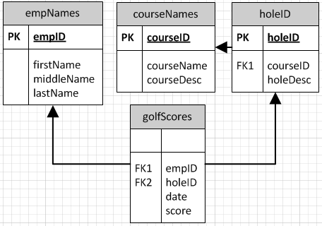
SQL Training
Why use a database
Normalizing the golf-club example:
No repetition of facts: Names are only listed once.
Coherent groupings: Member name info is stored separately from course name info.
Most essential fact: Each nine hole grouping is listed independently.
What else can we do?
Course ID | Course Name | Location
1 | Franklin Flats | Portland
2 | Gallant Greens | Beaverton
3 | Harbor Holes | Gresham
Name ID | Name
1 | Hans Avery
2 | Matt Provencher
3 | Ted Schleisman
Course ID | Hole Desc
1 | Front Nine
1 | Back Nine
2 | Front Nine
2 | Back Nine
3 | Front Nine
Name ID | Hole ID | Date | Score
1 | 1 | 03/09/2012 | 45
2 | 1 | 03/09/2012 | 35
2 | 2 | 03/09/2012 | 30
3 | 3 | 05/15/2012 | 37
3 | 4 | 05/15/2012 | 38
1 | 5 | 07/22/2012 | 42
3 | 1 | 04/10/2012 | 48
3 | 2 | 04/10/2012 | 42

Slide 12
SQL Training
Why use a database
Tables are not Spreadsheets
A relation (table) is a collection of attributes (columns) and tuples (rows)
A relational database is a collection of normalized relations with distinct names
A relation schema is defined by a set of attribute and domain name pairs (primary keys, foreign keys, candidate keys…)
This is different from a Spreadsheet – despite looking very similar to each other!
A Spreadsheet is a collection of cells arranged in a 2D array – which can be organized to act very similar to a table

Slide 13
What is SQL?
SQL Training
How we got here
Structured Query Language (SQL) is the querying language we use to access databases.
There are many variations of the standard, such as Microsoft’s Transact-SQL (T-SQL).
Our servers at M are running Microsoft SQL Server.
We will write SQL queries and pull data from our servers using Microsoft SQL Server Management Studio.

Slide 14
Agenda
SQL Training
How we got here
Why use a database
Anatomy of a SQL statement
Creative anatomy
Making your mark on the world
Shooting yourself in the foot
Getting data in and out of the database

Slide 15
SQL Training |
Anatomy of a SQL Statement
Clauses
SQL code consists of several different clauses, each of which dictates certain aspects of your query.
We’ll cover the SELECT, FROM, WHERE, GROUP BY, HAVING and ORDER BY clauses today.
There are many other clauses with SQL, but these five are the most frequently used.
Other clauses include UNION, INSERT, and UPDATE.
Management Studio features contextual highlighting to help identify certain parts of a query. Clauses are generally highlighted in BLUE.

Slide 16



SQL Training |
Anatomy of a SQL Statement
The Select Clause
The first clause in any query that you’ll write is SELECT.
This clause dictates the attributes that you’d like to see output in the query results window.
More than one output can be obtained by separating them with commas.
Any functional transformations will be done within the select clause.

Slide 17
SQL Training |
Anatomy of a SQL Statement
The From Clause
The second clause in a query is FROM
This clause dictates the source that you’re pulling data from.
An example with the AdventureWorks database would be to select data from the “Person.Person” table:
SELECT TOP 10 * FROM Person.Person
The “*” tells the database to return all attributes from the data set (in this case, it would be all attributes within the Person.Person table.)
“TOP 10” tells the server not to return more than ten records.
We can use aliases to easily reference a table

Slide 18
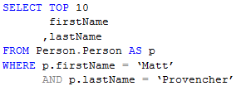
SQL Training |
Anatomy of a SQL Statement
The Where Clause
The third clause in your query will be WHERE.
This clause puts a filter on the data set described within the FROM clause.
This allows you to discriminate on your data, and exclude subsets from your results window.
You can utilize logical operations within your WHERE clause.

Slide 19
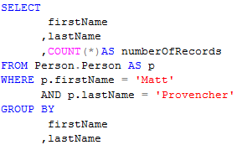
SQL Training |
Anatomy of a SQL Statement
The Group By Clause
The fourth clause in your query will be GROUP BY.
This clause helps to summarize data.
GROUP BY must be used when you need to aggregate certain parts of your data in order to utilize aggregate functions (SUM(), AVERAGE(), MIN(), MAX(), COUNT(), etc.)
For example, this query will tell us how many records our database has for people named “Matt Provencher”:

Slide 20
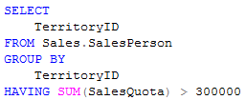
SQL Training |
Anatomy of a SQL Statement
The Having Clause
The fifth clause in your query is the HAVING clause.
This clause is used to apply discrimination to aggregated figures, such as sums.
As mentioned in the GROUP BY slide, the HAVING clause must be used in conjunction with the GROUP BY clause.

Slide 21

SQL Training |
Anatomy of a SQL Statement
The Order By Clause
The last clause in your query, and the last that we’ll cover today, is the ORDER BY clause.
This clause is necessary when reporting data because our stored records don’t have a specific order of storage (remember the parking example.)
ORDER BY will only affect the data output to the results window when coupled with the TOP statement, otherwise ORDER BY will only affect how your query results are displayed.
You can use ASC or DESC to indicate ascending or descending order.

Slide 22
SQL Training |
Anatomy of a SQL Statement
Clause Order
It is important to note that the order of your clauses is important.
Even though some of the clauses are optional, they will always appear in the following order:
SELECT
FROM (optional)
WHERE (optional)
GROUP BY (optional)
ORDER BY (optional)
HAVING (optional)

Slide 23
Aliasing
SQL Training |
Anatomy of a SQL Statement
SQL will generally allow you to take shortcuts when you’re referring to attributes within a table.
SQL views an attribute by its WHOLE name:
[Database Name].[Schema].[Table Name].[Column Name]
As long as there are no other identically named columns within your query, SQL will allow you to omit everything but the column name.
Aliasing (using the AS statement) allows you to very easily provide a ‘nickname’ for items within your query.
You can then use your alias, rather than typing out the complete path to your desired column.
You can alias columns as well, but you cannot use their nickname until after the query has been executed (no aliases in the GROUP BY or WHERE clauses)

Slide 24

Different Join Types
SQL Training |
Anatomy of a SQL Statement
There are many different join types in SQL, but the most frequently used are LEFT and INNER:
The JOIN clause always follows the FROM clause.
Following the JOIN clause will be the ON clause, specifying the criteria on which you’re joining your tables.
The ON clause is not used with the CROSS JOIN
You can have multiple criteria within the ON clause, and you can use any sort of Boolean (TRUE/FALSE) logic.

Slide 25
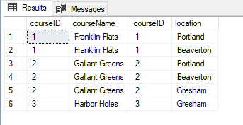

The INNER join
SQL Training |
Anatomy of a SQL Statement
An INNER JOIN will display only the rows that are contained within both data sets.
For example: Would return:
We can see that Dicey Downs is excluded from our results, because it wasn’t present in the courseLocations table.

Slide 26
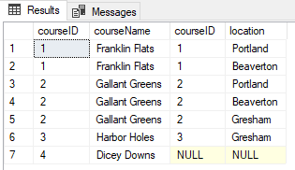

The LEFT join
SQL Training |
Anatomy of a SQL Statement
The LEFT JOIN will display all rows in the table to the “left” of the JOIN clause, and only those rows that meet the criteria listed in the ON clause in the table to the right.
For example: Would return:
Despite not being in the courseLocations table, Dicey Downs is now displayed in the results.
However, without any matching row within the location table, a NULL value is displayed.

Slide 27

The RIGHT join
SQL Training |
Anatomy of a SQL Statement
The RIGHT JOIN will display all rows in the table to the “right” of the JOIN clause, and only those rows that meet the criteria listed in the ON clause in the table to the left.
For example: Would return:
Note that this same output was achieved by using a LEFT JOIN and switching the order of the tables.

Slide 28

The FULL join
SQL Training |
Anatomy of a SQL Statement
The FULL JOIN will combine the results of LEFT JOIN and RIGHT JOIN.
For example: Would return:

Slide 29
Agenda
SQL Training
How we got here
Why use a database
Anatomy of a SQL statement
Creative anatomy
Making your mark on the world
Shooting yourself in the foot
Getting data in and out of the database

Slide 30
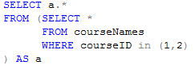

Subqueries
SQL Training
Much like keying a query off of a query in Access, you can target queries in SQL.
Saved queries are referred to as ‘views’.
What’s more, is you can query your query, without having to first save your sub-query as a view.
You can use this technique in the FROM clause, or in any JOIN clause.

Slide 31
Nesting Queries
SQL Training
Subqueries
Nesting queries is a great method to query on aggregate criteria, or to apply a second level of aggregation. Some examples:
Select the minimum of the maximums in your data set
Return the relative percentage of numbers in your data set
Returning all policies with a base-policy issue date before some year
Normalizing denormalized data on the fly

Slide 32


Unions
SQL Training
Used to combine the result-set of two or more select statements. Examples
Combine data from two different sources
Create summarized information of a table
Use a Union All statement to eliminate duplicate items from combined statements

Slide 33


CTE (Common Table Expression)
SQL Training
A temporary result set used to simplify a complex queries
Promotes readability, substitute for a permanent view
Temp tables can also be used as a temporary result set

Slide 34

Window functions
SQL Training
A window function performs a calculation across a set of table rows that are related to the current row
Possible aggregate functions include SUM, COUNT, AVG, RANK, ROW_NUMBER
Example: Counts how many Member Firms started on the particular start date
Rank and Row_Number are useful for finding the previous record or the next record in transactional data sets

Slide 35
Agenda
SQL Training
How we got here
Why use a database
Anatomy of a SQL statement
Creative anatomy
Making your mark on the world
Shooting yourself in the foot
Getting data in and out of the database

Slide 36
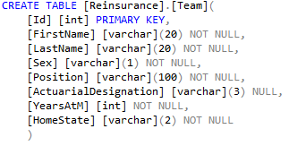

CREATE TABLE
SQL Training
The truth about “CREATE TABLE”…
A tacit statement: creates table!
Data types dictate type of data columns can hold
Constraints (NOT NULL, PRIMARY KEY) are important.

Slide 37

All about CONSTRAINTS…
SQL Training
Specified when creating or altering tables
Accentuates accuracy and reliability of data
Mission aborts if constraint violated
Common Constraints
NOT NULL - column cannot have NULL value
UNIQUE – dictates all values in column are different
PRIMARY KEY = NOT NULL + UNIQUE
FOREIGN KEY – unique identifier of record in exogenous table
CHECK – all values in column must satisfy a condition
DEFAULT – sets default value when none specified
INDEX – lends itself to creating/retrieving data efficiently

Slide 38




INSERT
SQL Training
Use “INSERT INTO” when adding records to a table
Two ways:
1. Specify column names
2. Populating all columns

Slide 39
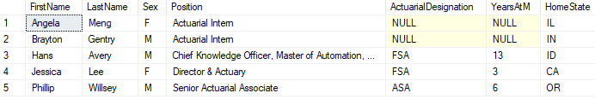

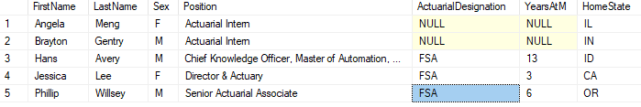
UPDATE
SQL Training
Before:
The Good:
Modifies existing records in a table
Quick and dirty
The Bad:
Can be too dirty… arguably cavalier!
No trail of breadcrumbs (save scripts!)
After:
The Ugly:
The “WHERE” clause is significant!
Otherwise, all records will be updated…
Watch for multiple updates

Slide 40



DELETE
SQL Training
Used to delete records in a table
Two ways:
1. Delete upon certain criteria
2. Delete all from table
Coming this August…

Slide 41
Agenda
SQL Training
How we got here
Why use a database
Anatomy of a SQL statement
Creative anatomy
Making your mark on the world
Shooting yourself in the foot
Getting data in and out of the database

Slide 42
Don’t Shoot Yourself in the Foot
SQL Training
Cautionary Tales
SQL has many handy tools, but being unaware of your process or data can lead to trouble:
Select Distinct statements
Join conditions
Data types
Reproducibility

Slide 43
Select Distinct
SQL Training
Cautionary Tales
Collapses all records that have the same information into one record.
Helpful when selecting only certain information from a table that results in duplicates.
Example:

Slide 44
Select Distinct
SQL Training
Cautionary Tales
Check your join conditions!
Might be missing a join criteria
Tread carefully when inheriting queries using Select Distinct statements.
Changes to underlying tables over time
Updating conditions

Slide 45
SQL Training
Cautionary Tales
Join Conditions
Beware of NULL values!
If there is a join on one field from Table A to Table B, if the value is NULL for both fields, the two records will not be joined.
NULL values in general can behave strangely and cause your query to not work as expected.
Try these out at sqlzoo.net!
Try to make join conditions as easy to follow as possible.
Select 'This will print' where 1 = 1
Select 'This will print' where 1 <> 2
Select 'This will not print' where 1 <> NULL
Select 'This will not print' where NULL = NULL

Slide 46
SQL Training
Cautionary Tales
Data Types
When loading data, types matter!
May error out completely if you try to put a row of strings into an INT data type field.
May only drop certain records that violate the data type, such as trying to enter a string with 15 characters into a VARCHAR(10) field.
If one column in a record violates a data type in a table, that entire record will be dropped.
You can’t join fields that are different data types.
Know the data types of the fields you are querying when using filtering functions.
Can’t use a wildcard on an INT field, matching on a string will miss an INT index.

Slide 47
SQL Training
Cautionary Tales
Reproducibility
Write queries to grab information from a snapshot in time.
Refrain from using databases that evolve regularly without any fields that provide some sort of time stamp (like an activity date).
Reproducing results at a later time helps in reviewing work
Can help validate that the query was the correct one used to produce results
Can be very helpful if there is limited documentation

Slide 48
Agenda
SQL Training
How we got here
Why use a database
Anatomy of a SQL statement
Creative anatomy
Making your mark on the world
Shooting yourself in the foot
Getting data in and out of the database

Slide 49
Methods for loading data into SQL
SQL Training
Insert Statements/Excel
Flat Files/Bulk Inserts

Slide 50
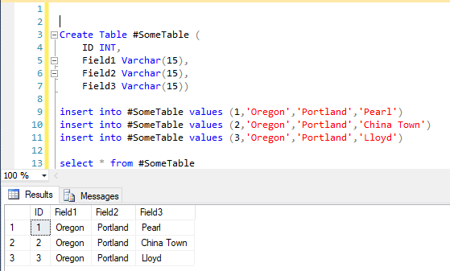
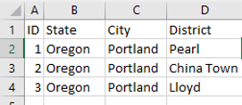
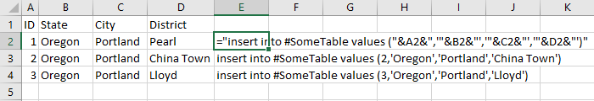
SQL Training
Basic Insert Statements
You can type out in SQL by hand
You can create an Excel formula and create the insert statements in mass.

Slide 51
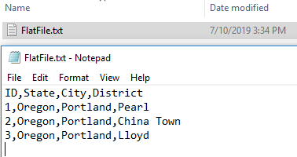
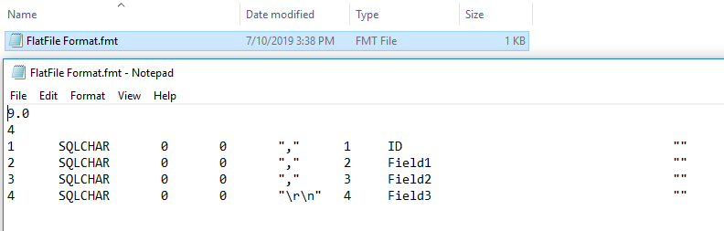
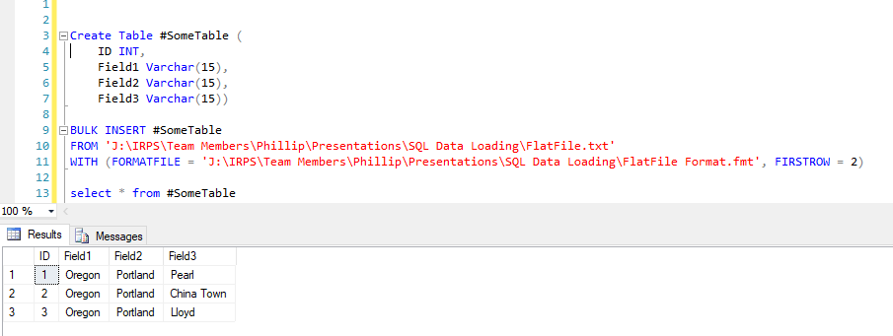
SQL Training
Flat Files and Bulk Insert Statements

Slide 52
Agenda SQL SUPER HOT TIPS
SQL Training
How we got here
Why use a database
Anatomy of a SQL statement
Creative anatomy
Making your mark on the world
Shooting yourself in the foot

Slide 53

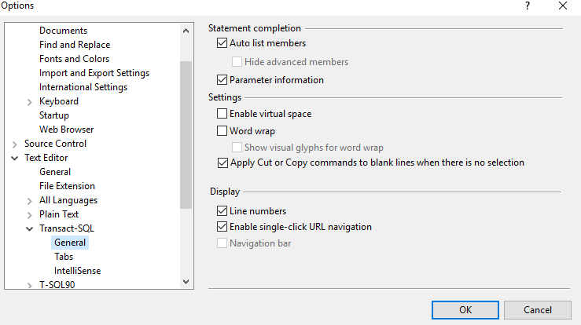
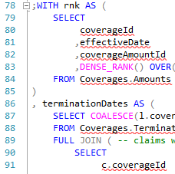

SQL SUPER HOT TIPS
SQL Training
1. Turn on Line Numbers
2. “ - - “ to comment out line
3. Ctrl + Shift + C to copy with headers

Slide 54
GIVE IT A TRY!
SQL Training

Slide 55
https://sqlzoo.net/
A website to practice some basic SQL commands
Premade tables to practice joins and filtering
Additional tasks to try and resources to use
Using the “World” table:
Which country has a larger population, Cuba or Bulgaria?
How many countries are included for each continent?
Using the “Game” and “Goal” tables:
What field(s) could be used to join these tables?
Rank teams from most to least gtime
Bonus: Which player is the best player on that team, according to their gtime?

Slide 56
Answers:
Which country has a larger population, Cuba or Bulgaria?
SELECT name, population FROM world WHERE name in ('Cuba','Bulgaria')
How many countries are included for each continent?
SELECT continent, count(name) as 'Number of Countries' from world Group by Continent
Notice anything funny with the results?
What field(s) could be used to join these tables?
select top 1 * from game select top 1 * from goal
Rank teams from most to least gtime
select teamid, sum(gtime) as 'TotalTime' from goal group by teamid order by sum(gtime) desc
Bonus: Which player is the best player on that team, according to their gtime?
select top 1 player from goal where teamid = (select top 1 teamid from goal group by teamid order by sum(gtime) desc) group by player order by sum(gtime) desc

Slide 57
http://mystery.knightlab.com/
A murder mystery game where you deploy your newfound SQL skills to find who did it!

